Slide 1
CPE 703 Research Seminar on Selected Topics in Chemical Engineering
Chemical and Petrochemicals Engineering Department
School of Energy, Environmental, Chemical and Petrochemicals Engineering
Egypt-Japan University of Science and Technology
(E-JUST)

Slide 2
General Techniques for Synthesis of Metal Organic Frameworks
By: Mostafa M. Sayed
PhD Student - Chemical and Petrochemicals Engineering Department.
School of Energy, Environment, Chemical, and Petrochemicals Engineering.
Egypt-Japan University of Science and Technology (E-JUST), Borg El Arab City, Alexandria, Egypt.
Mail: mostafa.mahmoud@ejust.edu.eg

Slide 3
Contents
Introduction : Nanoporous Materials ( What are?, and types)
Review of Metal-Organic Frameworks
Basic structure
Structural feature
Important of pore size
Preparation of MOFs
Common Ligands used for MOFs
Properties of MOFs
For better application
Synthesis Method
- Advantages and disadvantages of MOFs synthesis methods.
Conclusion

Slide 4
Introduction
Introduction: Nonporous Materials
Consist of a regular organic or inorganic structure, supporting a periodic Porous System.
The pore size (r) according to the radii of the pores is checked in four stages, according to IUPAC standards.
Nonporous material
3. Micropores
(0.4 nm< r < 2 nm)
2. Mesoporous
(2 nm< r <50 nm)
1. Macropores
(r > 50 nm)
4.Nano/Submicropores
(r < 0.4 nm)
Notes:
The International Union of Pure and Applied Chemistry (IUPAC)

Slide 5
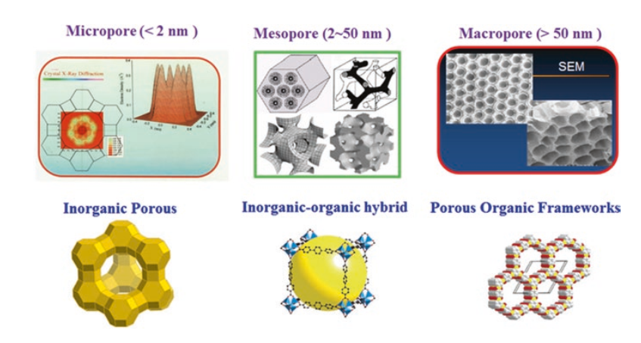
Introduction
Porous materials could be classified according to their pore size and their components
Notes:
DOI 10.1007/978-3-662-45456-5

Slide 6
Introduction
MOFs
Nonporous
ZEOLITES
POFs

Slide 7
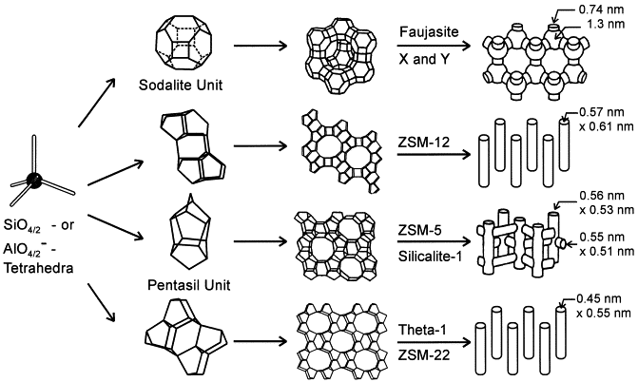
Introduction
ZEOLITES: ( INORGANIC NANOPOROUS COMPOUNDS)
Zeolites are microporous crystalline solids with well-defined structures. Generally, they contain silicon, aluminum and oxygen in their framework and cations, water and/or other molecules within their pores.
Zeolites form with many different crystalline structures, which have large open pores ( sometimes referred to as cavities) in a very regular arrangement and roughly the same size as small molecules.
The most interesting thing about zeolites is their open, cage-like framework structure and the way it can trap other molecules inside it.
Notes:
Fig. 1. Structures of four selected zeolites (from top to bottom: faujasite or zeolites X, Y; zeolite ZSM-12; zeolite ZSM-5 or silicalite-1; zeolite Theta-1 or ZSM-22) and their micropore systems and dimensions.

Slide 8
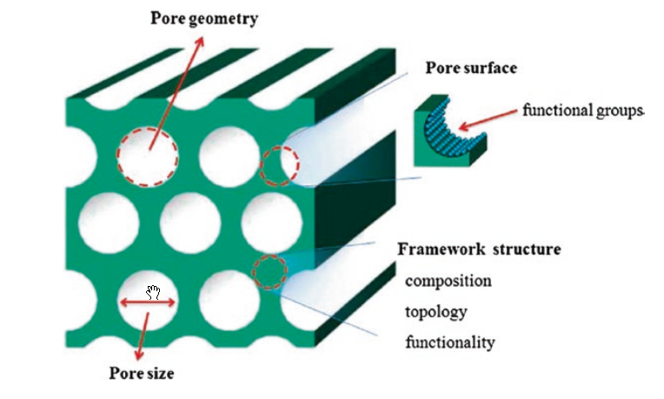
Introduction
POFs: (ORGANIC NANOPOROUS COMPOUNS)
POFs are composed of different organic moieties linked by covalent bonds, resulting in ordered and rigid structure.
Exceptional Thermal stabilities and low Frameworks Densities.
Exhibit permanent porosity and specific surface areas.
Application: Gas storage, Separation, Catalysis and etc.
Illustration of pore geometry, pore surface, pore size, and framework structure of porous polymers
Notes:
Porous Organic Frameworks (POFs)
DOI 10.1007/978-3-662-45456-5

Slide 9
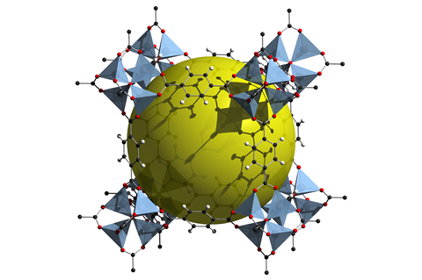
Introduction
MOFs: (HYBRID ORGANIC-INORGANIC NANOPOROUS COMPOUNS)
Metal-Organic Framework, abbreviated to MOF, is a Coordination Polymer ( or alternatively Coordination Network) with an open framework containing potential voids.
MOFs are self-assembled metal clusters with organic ligands, are well known for their structure, permanent porosity, and tunable properties and have shown great prospect for various applications.
Example of MOF-5 with yellow sphere filling the pore
Notes:
MOF-5 or IRMOF-1 is a Metal-organic framework compound with the formula Zn4O(BDC)3, where BDC2−=1,4-benzodicarboxylate (MOF-5) It was found by Omar M. Yaghi.
In 1999, researchers proved that a new wonder material called MOF-5, first made only a few years earlier, had more than three times the internal surface area of the most porous zeolite.

Slide 10
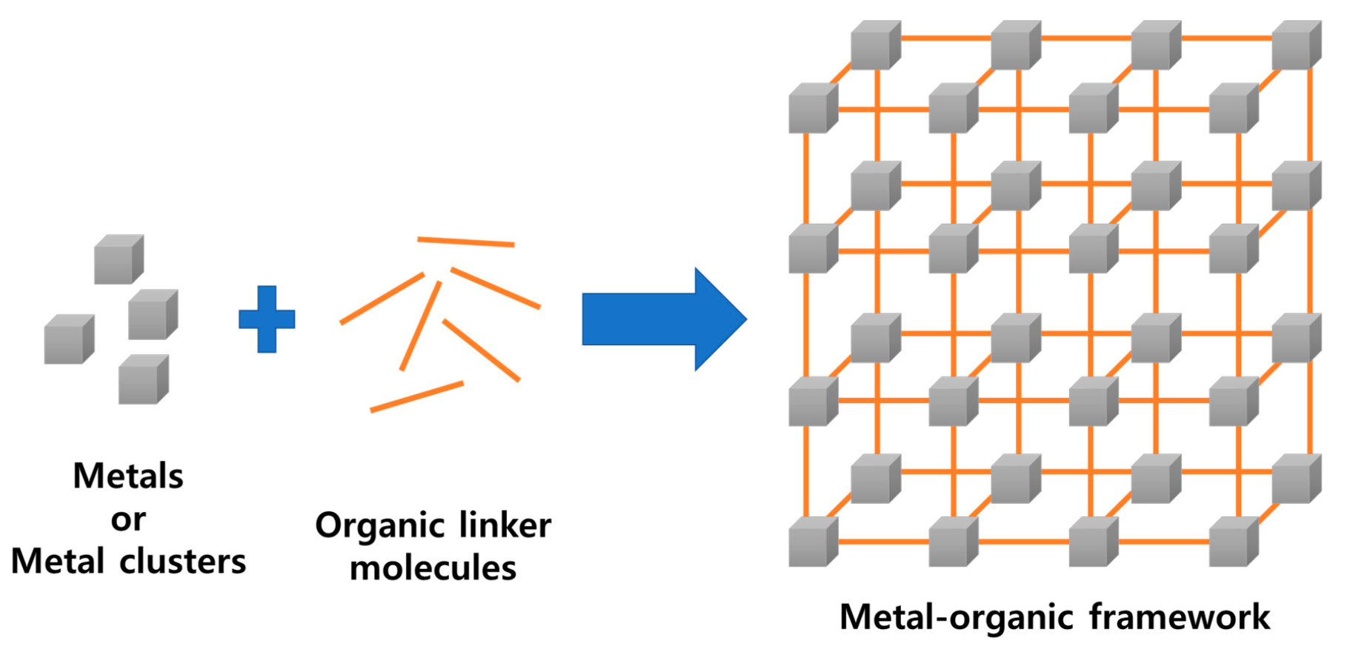
Review of Metal-Organic Frameworks
Basic Structure
MOFs structures made up of inorganic nodes, which can either be single ions or clusters of ions, and organic linkers.
Notes:
Polymers 2020, 12(9), 2061; https://doi.org/10.3390/polym12092061

Slide 11
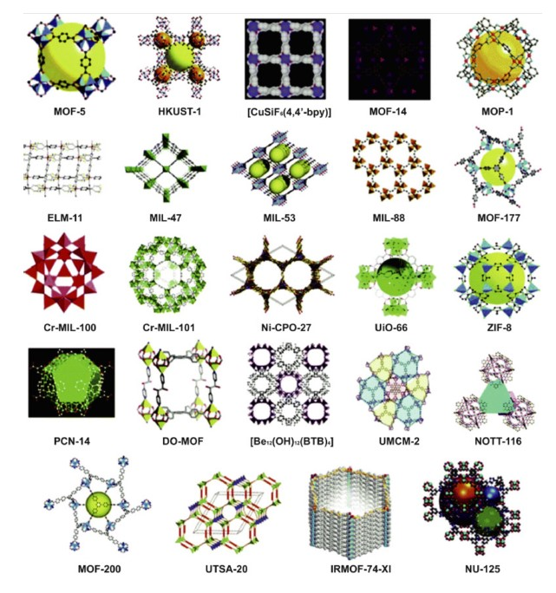
Review of Metal-Organic Frameworks
Structural Features
They contain potential voids which can be used for various application.
Very low density
Crystalline
Large voids
Significant van der Waals interaction
Complex unit cell
Notes:
https://sciencemystic.com/metal-organic-frameworks-mofs/

Slide 12
Review of Metal-Organic Frameworks
Important of MOFs pore size
1
Many potential applications of MOFs depends on the size and nature of the available free volume or pores within the frameworks structure
2
Tuning of the pores is typically achieved by variation of the metal ions or organic ligands
3
Lengthening the organic chains can lead to increased pore size but is often limited by a decrease in stability of the framework.

Slide 13
Review of Metal-Organic Frameworks
With no gas present, the thermal conductivity decreases with increasing pore size. In the presence of adsorbed gas, MOFs with smaller pores experience reduced thermal conductivity due to phonon scattering introduced by gas crystal interactions.
4
5
For larger pores (>1.7 nm), the adsorbed gas does not significantly affect thermal conductivity.
6
This difference is due to the decreased probability of gas-crystal collisions in larger pore structures.

Slide 14
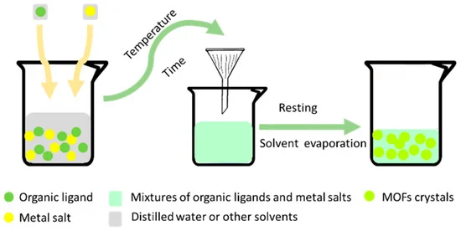
Review of Metal-Organic Frameworks
Preparation of MOFs
Notes:
Processes 2018, 6(8), 122; https://doi.org/10.3390/pr6080122

Slide 15
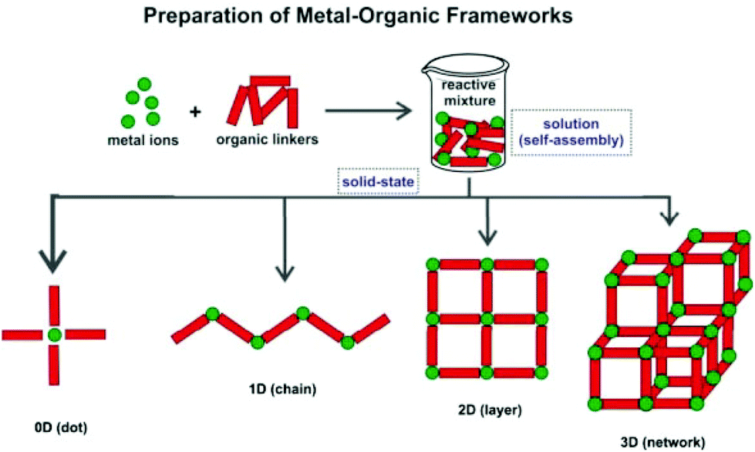
Review of Metal-Organic Frameworks
The coordination complex formed by the metal ions and the donor atoms of the linker, termed the secondary building unit (SBU), dicates the final topology of the MOF framework.
Notes:
DOI: 10.1039/C4QI00222A

Slide 16
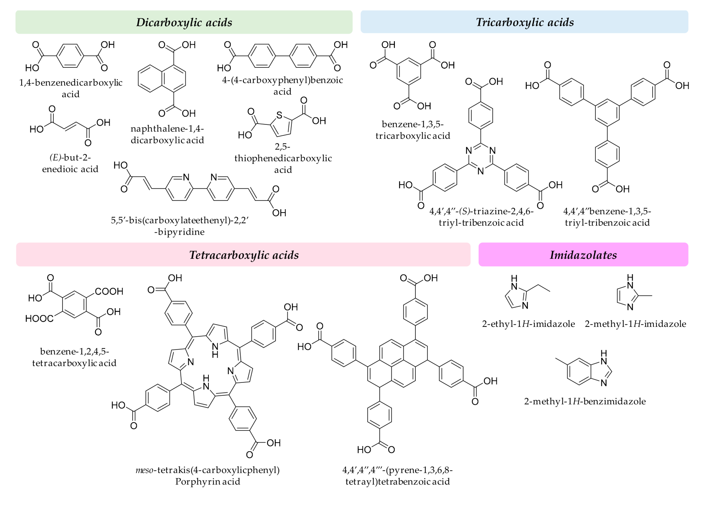
Review of Metal-Organic Frameworks
Common ligands used for MOFs
Notes:
Representative examples of organic ligands used in MOF synthesis.
Separations 2019, 6, 33; doi:10.3390/separations6030033

Slide 17
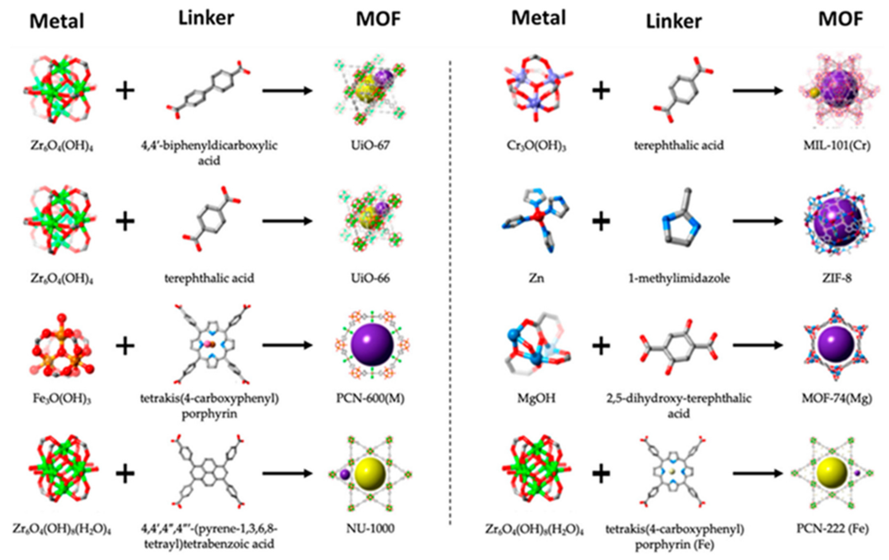
Review of Metal-Organic Frameworks
Schematic illustration of the molecular structure of common metals and ligands and the MOFs resulting from their combination.
Notes:
J. Compos. Sci. 2020, 4(2), 75; https://doi.org/10.3390/jcs4020075

Slide 18
Review of Metal-Organic Frameworks
Properties of MOFs
The backbone of the compound is constructed from metal ions which act as connectors and organic bridging ligands as linkers.
Readily accessible porosity.
The coexistence of inorganic ( hydrophilic) and organic ( hydrophobic) moieties in structure may influence on adsorption properties.
Although most of MOFs are electrical insulators, several materials in this class have recently demonstrated excellent electrical conductivity and high charge mobility.
The thermal stability of MOFs is determined by the coordination number and local coordination environment instead of framework topology.
In general MOFs are poor thermal conductors with thermal conductivity that is similar to concrete.

Slide 19
Review of Metal-Organic Frameworks
Properties of MOFs
Surface area
The active surface area is the most defining and significant physical feature of MOFs.
Pore diameter and porosity
The structure and size of the pores are another essential aspect of MOFs. The MOF structure has a wide pore size distribution that ranges from macro to nano.
Surface features and crystalline structure
MOF structures can be divided into four categories:
Rigid framework structures
Flexible/dynamic framework structures
Surface functional framework
Open metal areas

Slide 20
Review of Metal-Organic Frameworks
For better application
Surface Area: MOFs with higher surface area are more desirable.
Pore Size: MOFs must have the proper pore size to allow uptake and release of analytes.
Stability: MOFs must exhibit reasonable stability upon exposure to oxygen, moisture, the analytes of interest or changes in temperature.
Solubility: MOFs should be insoluble in aqueous media.
Analyte interaction: MOFs may exhibit special structural characteristics that may facilitate selective uptake and release of analytes.

Slide 21
Synthesis of MOFs
Synthesis of MOFs
Different methods of synthesis of MOFs have been described:
1) Non-solvothermal ( open flasks, below the solvent boiling point, at atmospheric pressure)
A) Traditional synthesis:
2) Hydrothermal/solvothermal ( special closed chemical reactors, boiling temperature of the solvent or above this boiling point, elevated pressure caused by solvent vapor or produced by a pump.)
Notes:
The term solvothermal implies the use of any solvent and is more general than the term hydrothermal used where the solvent is water.

Slide 22
Synthesis of MOFs
A) Traditional synthesis
Notice:
Method 1) dose not require complex equipment
Method 2) Solvothermal synthesis affords higher yields and better crystallinity of the product.
But requires special equipment (autoclaves or sealed containers that can withstand increased pressure); in addition, the duration of the process should be considered (the synthesis can continue for several weeks and even months).

Slide 23
Synthesis of MOFs
A- 1) MOF synthesis by slow evaporation (non-solvothermal)
The slow evaporation (non-solvothermal) method is a conventional method to prepare MOFs at room-temperature, which mostly does not need any external energy supply.
Its major disadvantage remains that it requires more time compared with other well-known conventional methods.
In the slow evaporation method, a solution of the starting materials is concentrated by slow evaporation of the solvent at a fixed temperature, mostly at room temperature.

Slide 24
Synthesis of MOFs
A- 2) MOF synthesis by solvothermal method
Solvothermal reactions use autogenous pressure that above the solvent’s boiling point and take place in closed containers.
Solvothermal reactions have often been carried out with organic solvents that have high boiling point.
Solvothermal reactions can be performed at a range of temperatures, based on the reaction’s conditions.
Glass bottles for lower temperature reactions, but Teflon-lined autoclaves for temperatures beyond 400 K.
When the solvent is water , the technique called hydrothermal method instead of solvothermal method.
Notes:
Diethyl formamide, acetonitrile, dimethyl formamide, acetone, methanol, ethanol and other organic solvents are often utilized. Solvent mixtures have also been utilized to avoid difficulties with different starting components having variable solubilities.

Slide 25
Synthesis of MOFs
A- 2) MOF synthesis by solvothermal method
Lots of materials like inorganic chemicals or inorganic organic hybrid materials have been successfully synthesized using the solvothermal technique

Slide 26
Synthesis of MOFs
A) Traditional synthesis
Most of the time, MOFs are synthesized by combining organic ligands and metal salts in solvothermal reactions at low temperatures (below 300°C), that:
Polar solvent: Water, dialkyl formamides, dimethyl sulfoxide or acetonitrile.
The most important parameters of solvothermal: temperature, the source and concentration of metal salt and ligand (which can be varied across a large range), the solubility of the reactants in the solvent, PH of the solution, reaction time etc.

Slide 27
Synthesis of MOFs
1) Microwave synthesis
2) Electrochemical synthesis
B) Non-traditional synthesis:
3) Mechanochemical synthesis
4) Sonochemical synthesis

Slide 28
Synthesis of MOFs
1) Microwave synthesis
The synthesis of MOFs can be done relatively quickly using microwave-assisted synthesis.
To make nanoscale metal oxides, microwave-assisted techniques have been employed extensively.
Microwaves are used to heat a solution for around an hour to form nanosized crystals in these methods.
The microwave-assisted approach produces crystals of the same quality as the traditional solvothermal method.
However, the time that required fort the synthesis is reduced.

Slide 29
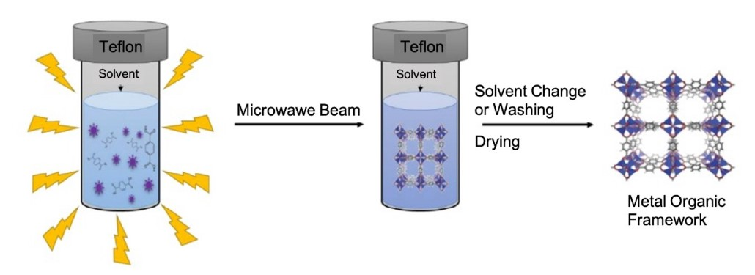
Synthesis of MOFs
1) Microwave synthesis

Slide 30
Synthesis of MOFs
2) Electrochemical synthesis
Electrochemical synthesis is technique, which does not need salts of metal and allows for the constant formation of MOF crystals.
Metal ions are introduced not from a solution of the corresponding salt or through the formation of these ions during the reaction of a metal with an acid, but as a result of electrochemical process.
That is a significant benefit in an industrial operation.
The core concept involves anodic dissolution of metal ions into synthesis mixtures containing electrolytes and organic linkers.
Notes:
It should be especially noted that this method affords both powders and films.

Slide 31
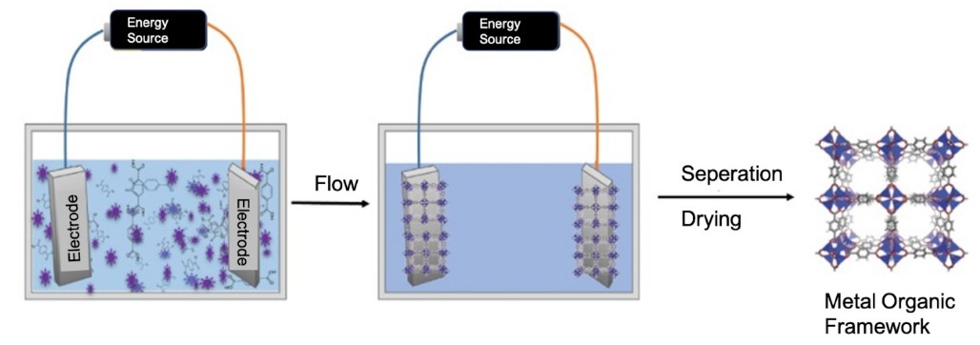
Synthesis of MOFs
2) Electrochemical synthesis

Slide 32
Synthesis of MOFs
3) Mechanochemical synthesis
Mechanochemistry studies reactions between solids usually initiated only by means of mechanical energy, for example, by milling in ball mills
Synthesis of MOFs using the mechanochemical method is a solvent-free method.
The use of mechanical force in a chemical reaction is known as mechanochemistry.
Mechanochemical processes are easy, cost-effective, and environmentally acceptable.
Liquid-assisted grinding (LAG), which involves introducing a small amount of solvent to a solid reaction mixture, has recently been employed to successfully synthesize MOFs.
Notes:
The most popular approaches are the hot-spot model and the magma – plasma model.
The former model considers the contact of two solid surfaces exposed to mechanochemical treatment.
The magma – plasma model focuses on the processes that occur directly at the contact spot of colliding particles

Slide 33
Synthesis of MOFs
3) Mechanochemical synthesis
Notes:
https://sciencemystic.com/metal-organic-frameworks-mofs/

Slide 34
Synthesis of MOFs
4) Sonochemical synthesis
The use of intense ultrasonic radiation (20 kHz–10 MHz) causes molecules to undergo chemical transformation, which is known as sonochemistry.
Ultrasound causes chemical or physical changes in a liquid through a cavitation process that involves the production, development, and quick collapse of bubbles, resulting in local hot spots with high temperature and pressure with a brief lifetime.
Extreme temperatures can speed up chemical reactions by forming an excess of crystallization nuclei right away.
When compared to traditional hydrothermal procedures, sonochemical approaches can produce homogeneous nucleation centers and a significant reduction in crystallization time.

Slide 35
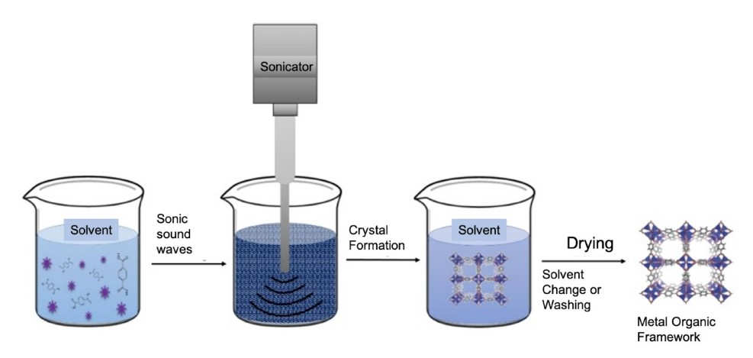
Synthesis of MOFs
4) Sonochemical synthesis

Slide 36
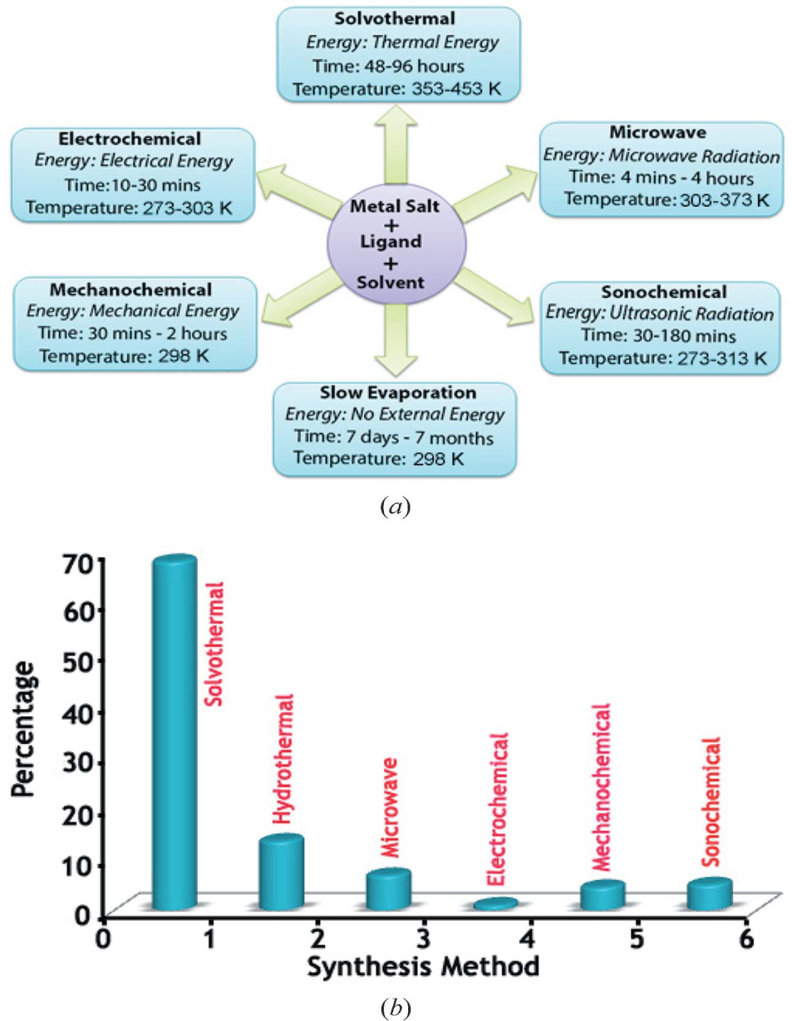
Synthesis of MOFs
Synthesis conditions commonly used for MOF preparation;
Indicative summary of the percentage of MOFs synthesized using the various preparation routes.
Notes:
Acta Cryst. (2014). B70, 3–10 doi:10.1107/S2052520613029557

Slide 37
Advantages and disadvantages of MOFs synthesis methods.
Advantages and disadvantages of MOFs synthesis methods.
Synthesis methods | Advantages | Disadvantages
Conventional solution | MOFs show chemical and thermal stability. Room temperature synthesis method. The crystallinity of MOFs takes place at a short time scale. | An upsurge of the reaction temperature is required in some systems to attain suitable crystallinity and reaction rates, exclusively if kinetically more inert ions are used
Notes:
https://doi.org/10.1016/j.tifs.2020.08.004

Slide 38
Advantages and disadvantages of MOFs synthesis methods.
Synthesis methods | Advantages | Disadvantages
Solvothermal synthesis | Single crystals are readily obtained. Single-crystal X-Ray Diffraction is used for structural characterization. | Soluble precursors are required. Heat and/or aggressive reagents (acids, organic solvents, bases) are needs for regent dissolution. Solvent waste generation is high. Potentially hazardous handling of explosive/corrosive metal salt (nitrate/chloride) in the presence of organic liquids. Waste mineral acids or salts are generated by reactions (e.g., HNO₃, HCl). Not applicable to heat-sensitive solvents and reagents.
Notes:
https://doi.org/10.1016/j.tifs.2020.08.004

Slide 39
Synthesis methods | Advantages | Disadvantages
Microwave synthesis | The fast reaction rate in a short reaction period. Possibility of controlling crystal size. Higher yield in remarkable phase purity and phase selectivity. Compact synthetic device usage. synthetic devices with low energy consumption while producing small amounts of chemical waste. | The possibility of changing the reaction conditions by regulatory the irradiation power is difficult. Diverse instruments are unable to deliver the same conditions, ultimately hindering reproducibility; therefore, time of reaction and the temperature is also its limitation.
Notes:
https://doi.org/10.1016/j.tifs.2020.08.004

Slide 40
Advantages and disadvantages of MOFs synthesis methods.
Synthesis methods | Advantages | Disadvantages
Electrochemical synthesis | Continuous synthesis process and can produce higher solids content compared to batch reactions. Can be used as an industrial method to synthesis MOFs | MOFs growth by anodic oxidation is possible only when continuous electrical contact of the complete metallic pattern to the power source is guaranteed.
Notes:
https://doi.org/10.1016/j.tifs.2020.08.004

Slide 41
Advantages and disadvantages of MOFs synthesis methods.
Synthesis methods | Advantages | Disadvantages
Mechnochemical synthesis | • Rapid synthesis (30–60 min) on multigram scale • Quantitative yields when using metal salts as precursors • No reagent excess • No solvent waste • Allows access to products and reactants sensitive to heat or solvents | • Structural characterization requires PXRD coupled with other techniques (e.g., solid-state NMR, thermal analysis, infrared spectroscopy) • Neat milling may lead to unwanted product amorphization
Notes:
Molecules 2017, 22, 144; doi:10.3390/molecules22010144

Slide 42
Advantages and disadvantages of MOFs synthesis methods.
Synthesis methods | Advantages | Disadvantages
Sonochemical synthesis | Fast, environmentally friendly, energy-efficient, room temperature method, nanocrystalline particles synthesis | Sometimes the temperature of the synthesis near the reactive mixture area cannot be controlled even though it is a room temperature synthesis method.
Notes:
https://doi.org/10.1016/j.tifs.2020.08.004

Slide 43
Conclusion
Different synthesis methods have been utilized to prepare MOFs at faster rates as well as in bulk quantities, and the reasonable choice of SBUs and ligands makes it possible to design topologically new compounds.
Since it is possible to tune pore size and functionality inside the cavities of MOFs, these unique aspects should enable porous MOFs as useful materials for diverse applications.

Slide 44
Thanks

